Slide 1
node.js
Pravinkumar Dabade

Slide 2
Agenda –
What is node.js?
Node benchmark
Blocking Vs Non-blocking operations
node.js project and design goals
Architecture
Node execution stack
Where to use node.js?
Introduction to NPM

Slide 3
Agenda –
First example of node.js
HTTP program
Introduction to require(); function
node.js module pattern

Slide 4
Introduction node.js
node.js is a set of bindings to Google’s V8 JavaScript VM [virtual machine].
Allows one to script programs that do I/O in JavaScript.
Focused on performance.

Slide 5
V8 – JavaScript Execution Engine
V8 is a JavaScript Execution Engine built for Google Chrome
It was open sourced by Google in year 2008
It is written in C++
V8 compiles JavaScript source code into Native code instead of interpreting in real time.

Slide 6
Libuv – Asynchronous Events
Node.js uses libuv to handle asynchronous events
Libuv is a software library – provides asynchronous event notifications
It provides –
Asynchronous TCP and UDP sockets
Asynchronous file and file system operations
File system events
Thread Pool, Signal handling, threading and synchronization

Slide 7
Benchmark
100 concurrent clients 1 megabyte response –
node : 822 requests/second
nginx : 708 requests/second
thin : 85 requests/second
mongrel : 4 requests/second
[Bigger is better]

Slide 8
Node JS code
http = require(‘http’);
Buffer = require(‘buffer’).Buffer;
n = 1024 * 1024;
b = new Buffer(n);
for ( var i = 0; i<n; i++) b[i] = 100;
http.createServer(function (req, res) {
res.writeHeader(200);
res.end(b);
}).listen(9000);

Slide 9
Doing I/O completely different
Many web applications have code like this :
result = query (‘select * from customers’);
[database is in some other city !!]
//Use result
What is the software doing while it is querying the database?
Answer – In many cases, just waiting for the response.

Slide 10
Modern Computer Latency
Pulled out from internet
To access the L1 and L2 cache –
L1 – 3 cycles
L2 – 14 cycles
RAM – 250 cycles
----------------------------------------------------------------
Disk – 41, 000, 000 cycles
Network – 240, 000, 000 cycles

Slide 11
Blocking and Non-blocking operations
Non – Blocking operations
L1, L2, RAM
----------------------------------------------------------------
Blocking operations
Disk and Network

Slide 12
Blocking operation
result = query (‘select * from customers’);
// This is Blocking operation
Any idea what it is doing behind the screen ...?
Actually No idea - You are calling a function from an API. We don’t know what’s it doing. Is it talking to some different city or doing some network operations ... Don’t know

Slide 13
Not all software block the execution
Better software can multitask.
Other threads can execute while the blocking code runs.
(but is that the best that can be done?)
Let’s look at Apache and NGINX..

Slide 14
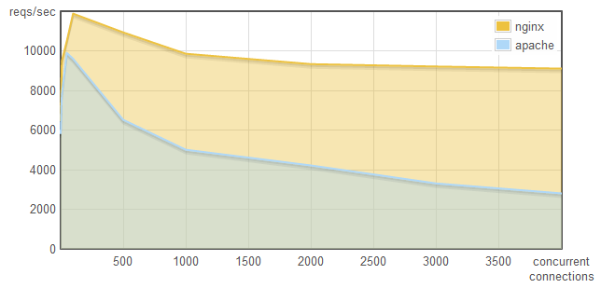
Nginx vs Apache request per second
https://blog.webfaction.com/2008/12/a-little-holiday-present-10000-reqssec-with-nginx-2/

Slide 15
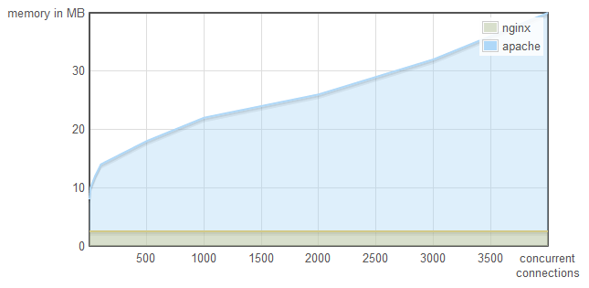
Nginx vs Apache memory uses
https://blog.webfaction.com/2008/12/a-little-holiday-present-10000-reqssec-with-nginx-2/

Slide 16
Apache Vs NGINX
Apache uses one thread per connection
NGINX doesn’t use threads. It uses an event loop.

Slide 17
Is multi-threading best?
Context switching between threads is not free
Execution stacks take memory
For massive concurrency, cannot use an OS thread for each connection

Slide 18
Green Threads and coroutine
What is green thread?
In computer programming, green threads are threads that are scheduled by a runtime library or virtual machine (VM) instead of natively by the underlying operating system

Slide 19
Performance in multi-threading
Green threads or co-routines can improve the situation dramatically
But there is still the machinery involved to create the illusion of holding execution on I/O.

Slide 20
Code like this ..
result = query(‘select ...’);
//use result
Either blocks the entire process or implies multiple execution stack.

Slide 21
But the line of code like this ..
query(‘select ...’ , function(result) {
// use result
});
Allows the program to return to the event loop immediately.
No machinery required

Slide 22
This is how I/O should be done
query(‘select ...’ , function(result) {
// use result
});

Slide 23
Why isn’t everyone using?
So why isn’t everyone using event loops, call backs and non-blocking IO?
For reasons both cultural and infrastructural

Slide 24
Cultural Bias
Code like this –
puts(“Enter you name -: ”);
gets(function (name){
puts(“Name is : “ + name);
});
is rejected as too complicated when 1000 users are connected.

Slide 25
Missing Infrastructure
Single threaded event loops require I/O to be non-blocking.
It must be handled very carefully
We don’t have the libraries which can offer these functionalities.

Slide 26
Missing Infrastructure
POSIX async file I/O not available
Portable Operating System Interface
Manual pages don’t state if a function will access the disk
No closures or anonymous functions in C, makes call-backs difficult
Database libraries [ex-libmysql.client] do not provide support for asynchronous queries.
Asynchronous DNS resolution not standard on most systems

Slide 27
JavaScript
JavaScript is designed specially to be used with an event loop –
Anonymous functions
Closures
Only one call back at a time
I/O through DOM event call backs

Slide 28
node js
The node.js project –
Provides a purely evented, non-blocking infrastructure to script highly concurrent programs.

Slide 29
Design Goals
No function should directly perform I/O
Always use call back –
To receive the information from disk, network or another process
Stream everything; never force the buffering of the data
Do not remove the functionality present at the POSIX layer.
POSIX - Portable Operating System Interface for UNIX

Slide 30
Design Goals
Have built-in support for the most important protocols –
DNS, HTTP, TLS [Transport layer security]
Support many HTTP features
Chunked encoding
Pipelined messages
Hanging requests for comet applications

Slide 31
Design Goals
The API should be familiar to –
Client side JS programmers
Platform independent
Make it enjoyable

Slide 32
Architecture
Node Standard Library
JavaScript
Node Bindings
C
V8
Thread Pool
Event Loop

Slide 33
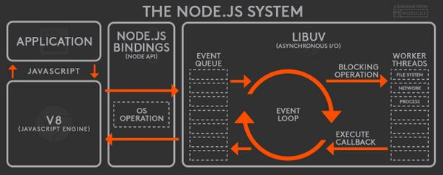
Architecture

Slide 34
Architecture
The JavaScript layer can access the main thread
The C layer can use multiple threads
For example, you want to make Gzip library and fork it out to 5 threads. You can write a node module using C.
Threads should be used by experts only.
Its a feature offered by node

Slide 35
Architecture
Put users in non-blocking environments
There is exactly one execution stack in Node

Slide 36
Node execution stack
load(“index.html”)
http_parse(1)
socket_readable(1)
ev_loop()

Slide 37
Node execution stack
Node sends a request to the thread pool to load “index.html”
The stack unwinds

Slide 38
Node Stack Unwind
load(“index.html”)
http_parse(1)
socket_readable(1)
ev_loop()

Slide 39
Node execution stack
The request is sent to the disk
Millions of clock cycles will pass before the process hears back from it
In the meantime someone else connects to the server
This time requesting an in-memory resource

Slide 40
Node execution stack
http_respond(2)
http_parse(2)
socket_readable(2)
ev_loop()
The stack unwinds and come back to event loop

Slide 41
Node execution stack
The process sits idle
The first request is still hanging
Eventually the disk responds

Slide 42
Node execution stack
http_respond(1)
file_loaded() – call back
ev_loop()
The stack unwinds and come back to event loop

Slide 43
When to use Node
Node is great for streaming or event-based real-time applications like:
Chat Applications
Real time applications and collaborative environments
Game Servers
Ad Servers
Streaming Servers

Slide 44
When to use Node
Node is great for when you need high levels of concurrency but little dedicated CPU time.
Great for writing JavaScript code everywhere!

Slide 45
Node in the Wild
Microsoft
Yahoo!
LinkedIn
eBay
Dow Jones
Cloud9
The New York Times, etc

Slide 46
The Node Community
Five years after its debut, Node is the third most popular project on GitHub.
Over 2 million downloads per month.
Over 20 million downloads of v0.10x.
Over 81,000 modules on npm.
Over 475 meetups worldwide talking about Node.
Reference: http://strongloop.com/node-js/infographic/

Slide 47
What is NPM?
Official package manager for Node.
Bundled and installed automatically with the environment.
Frequent Usage:
npm install --save package_name
npm update

Slide 48
What is a package.json?
{
"name": “Intro To Node",
"version": "0.1.0",
"description": “YASH IT Services Session",
"main": “server.js",
"author": {
"name": “Pravinkumar R. D.",
"email": “dabade.pravinkumar@gmail.com"
}
}

Slide 49
How does it work?
Reads package.json
Installs the dependencies in the local node_modules folder
In global mode, it makes a node module accessible to all.
Can install from a folder, tarball, web, etc…
Can specify dev or optional dependencies.

Slide 50


node.js – Hello World Program
Creating first example of node.js – Hello World

Slide 51
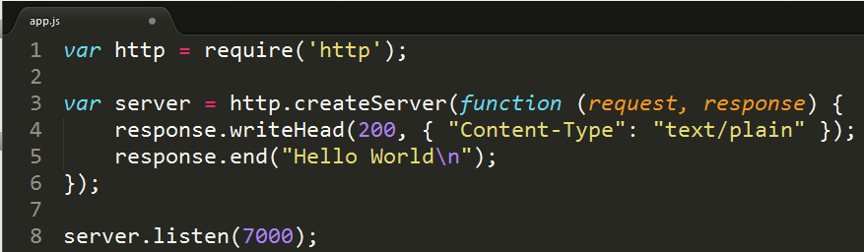
node.js – Hello World Http Program
Creating first HTTP program using http module

Slide 52

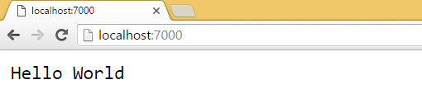
Execute – Hello World Http Program

Slide 53
node.js – require();
Node.js follows the CommonJS module system
The built-in require function is the easiest way to include modules that exist in separate files.
The require() function reads a JavaScript file, executes the file and proceed to return the exports object

Slide 54
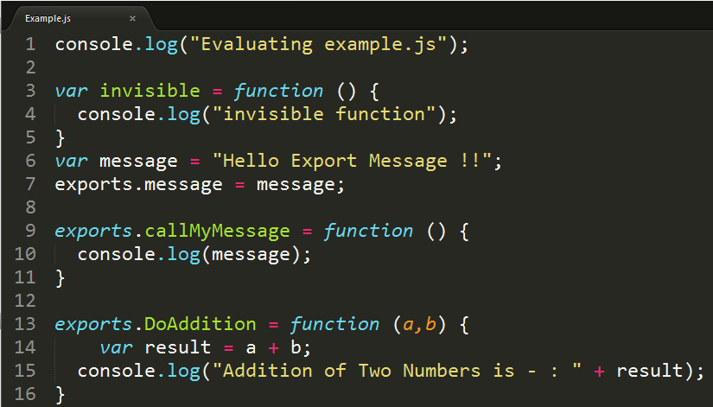
Testing require(); function
Create Example.js file

Slide 55
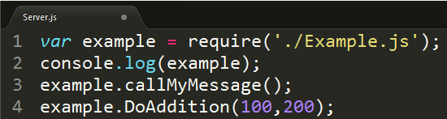
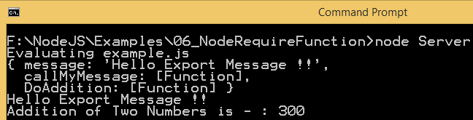
Testing require(); function
Using require(); function to read and execute JavaScript file [Example.js file]

Slide 56



node.js module pattern
Simple module pattern

Slide 57
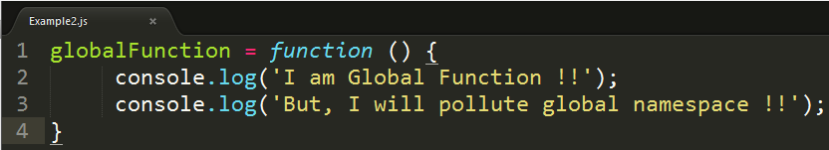

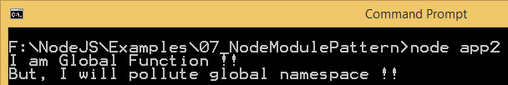
node.js module patterns
Define global functions. But, are we polluting the global namespace?

Slide 58
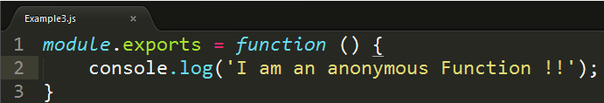


node.js module patterns
Export anonymous function

Slide 59
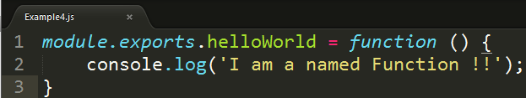


node.js module patterns
Export a named function

Slide 60
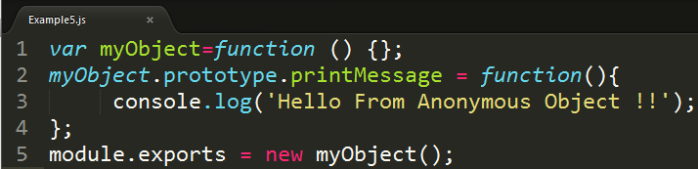


node.js module patterns
Export an anonymous object

Slide 61
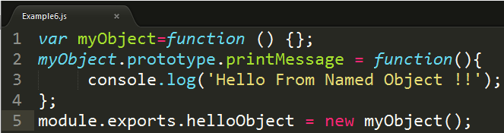


node.js module patterns
Export a named object

Slide 62
node.js REPL
R – Reads the input from the user and parse it to JavaScript function
E – Eval evaluate the JavaScript data structure
P – Prints the result
L – Loops the above command until user exits – ctrl –c twice

Slide 63
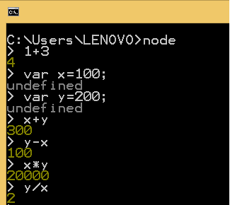
node.js REPL Examples
Simple examples –
Undefined – Variable declaration statement do not return any value

Slide 64
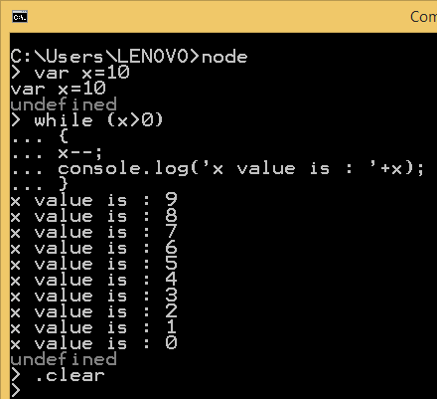
node.js REPL Examples
REPL – Multiline Expression

Slide 65
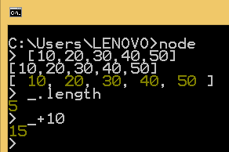
node.js REPL Examples
Special variable _ [underscore]

